Slide 1

6th Grade Accelerated Math
Unit 15, Lesson 5 Experimental and Theoretical Probability Volume 2, pg. 420

Slide 2


Benchmarks
MA.7.DP.2.3
Find the theoretical probability of an event related to a simple experiment.
MA.7.DP.2.4
Use a simulation of a simple experiment to find experimental probabilities and compare them to theoretical probabilities.
volume 2, pg. 420

Slide 3
Integrated Mathematical Thinking and Reasoning Standards
MA.K12.MTR.1.1 Actively participate in effortful learning both individually and collectively.
MA.K12.MTR.2.1 Demonstrate understanding by representing problems in multiple ways.
MA.K12.MTR.4.1 Engage in discussions that reflect on the mathematical thinking of self and others.
volume 2, pg. 420

Slide 4

Learning Targets
I can perform a simulation to determine an experimental probability.
I can find the theoretical probability of an event.
I can compare the experimental probability from a simulation to the theoretical probability of a simple experiment.
volume 2, pg. 420

Slide 5

Warm-Up
volume 2, pg. 421

Slide 6
15.5.1 Warm-Up: Marbles
Fill in the blanks in the statements below so the probability of drawing a red marble from either bag is the same. Use any number 1 through 9 at most one time each.
There are _____ red marbles and _____ blue marbles in Bag A. There are _____ red marbles and _____ green marbles in Bag B.
volume 2, pg. 421

Slide 7

Exploration
volume 2, pg. 421

Slide 8

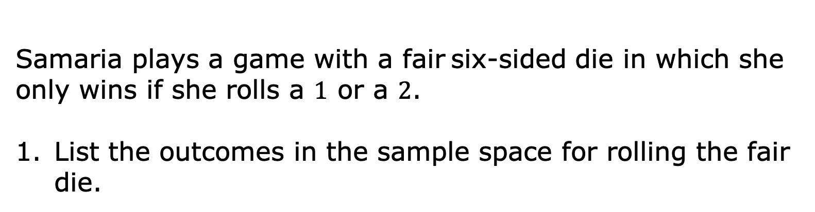
15.5.2 Exploration: Playing the Long Game
Samaria plays a game with a fair six-sided die in which she only wins if she rolls a $1$ or a $2$.
List the outcomes in the sample space for rolling the fair die.
volume 2, pg. 421

Slide 9
Discuss the probability of Samaria winning the game with your partner or group. Then, complete the statement.
The probability Samaria wins the game, represented as a fraction, is ____ because there are ____ possible winning outcomes out of ____ total possible outcomes from rolling the die.
If Samaria is given the option to flip a coin and win if it comes up heads, explain whether or not that would be a better option for her to win using probability.
volume 2, pg. 421

Slide 10
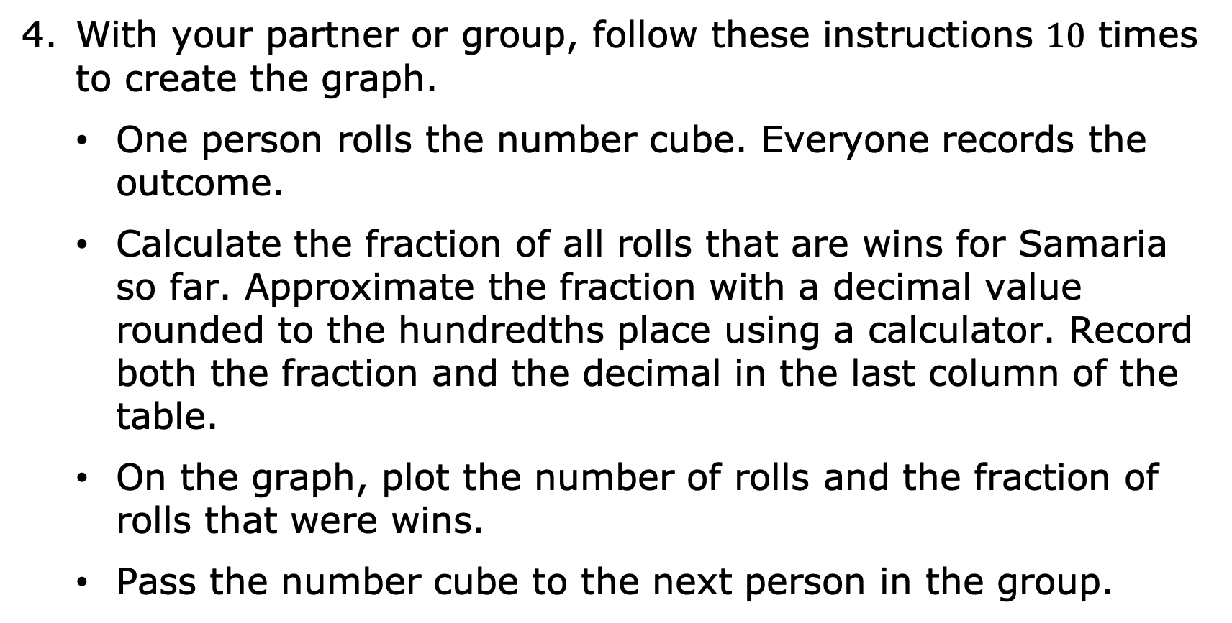
With your partner or group, follow these instructions $10$ times to create the graph.
One person rolls the number cube. Everyone records the outcome.
Calculate the fraction of all rolls that are wins for Samaria so far. Approximate the fraction with a decimal value rounded to the hundredths place using a calculator. Record both the fraction and the decimal in the last column of the table.
On the graph, plot the number of rolls and the fraction of rolls that were wins.
Pass the number cube to the next person in the group.
volume 2, pg. 422

Slide 11
Roll | Outcome | Total Number of Wins for Samaria | Fraction of Games Played that are Wins
1
2
3
4
5
6
7
8
9
10
volume 2, pg. 422

Slide 12
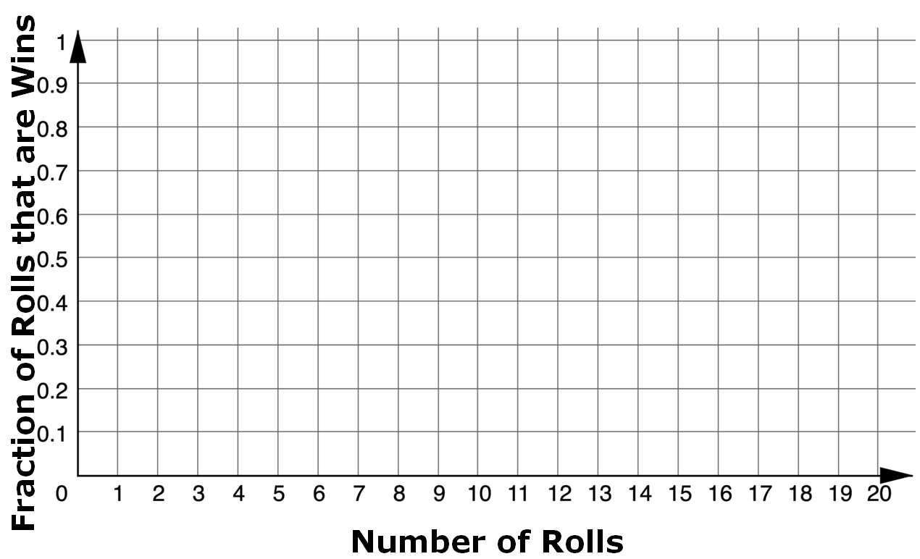
volume 2, pg. 422

Slide 13
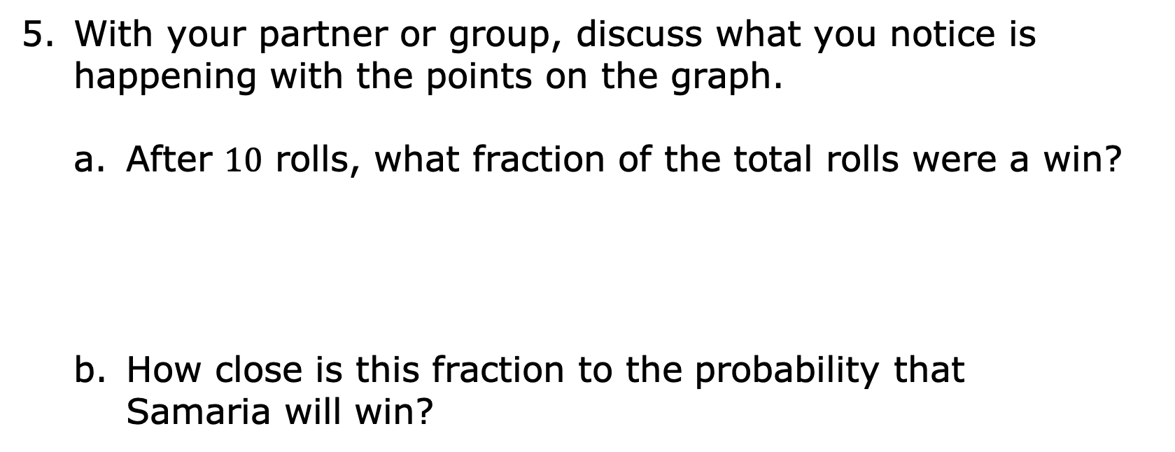
With your partner or group, discuss what you notice is happening with the points on the graph.
After $10$ rolls, what fraction of the total rolls were a win?
How close is this fraction to the probability that Samaria will win?
volume 2, pg. 422

Slide 14
Roll the number cube $10$ more times. Record your results in this table and add them to the graph from earlier.
Roll | Outcome | Total Number of Wins for Samaria | Fraction of Games Played that are Wins
16
17
18
19
20
21
22
23
24
25
volume 2, pg. 423

Slide 15
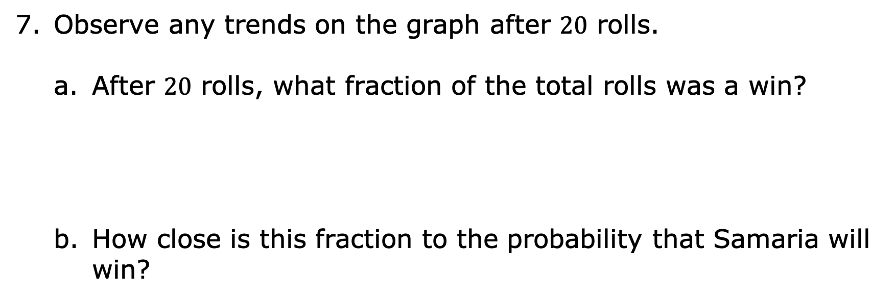
Observe any trends on the graph after $20$ rolls.
After $20$ rolls, what fraction of the total rolls was a win?
How close is this fraction to the probability that Samaria will win?
volume 2, pg. 423

Slide 16

Bring It Together
volume 2, pg. 423

Slide 17

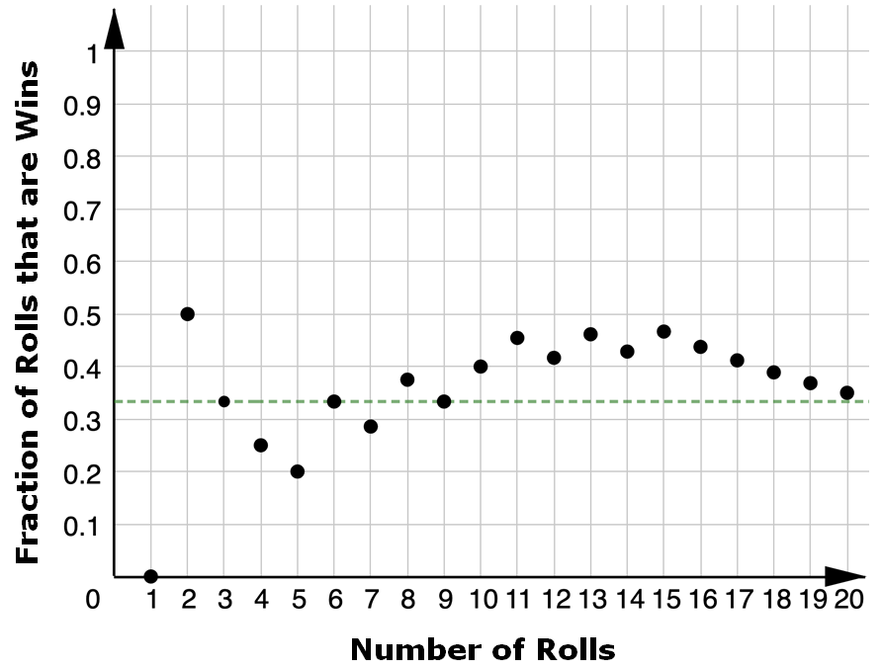
15.5.3 Bring It Together: Playing the Long Game
A sample graph from a group who performed the same simple experiment in the previous activity is shown.
What does the green dotted line represent on the graph?
volume 2, pg. 423

Slide 18
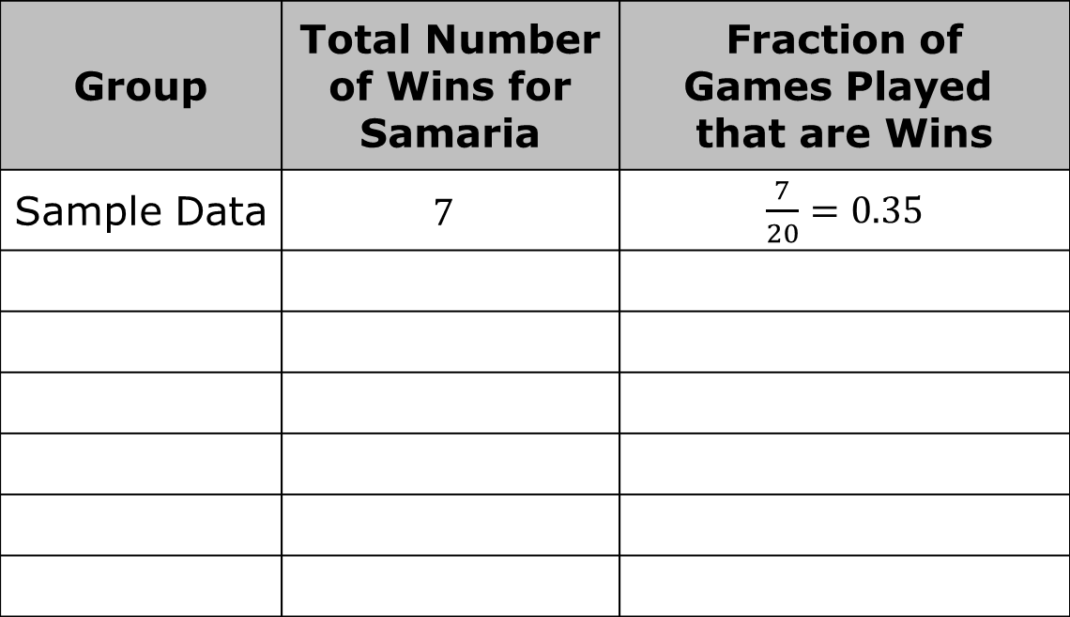
Consider the data from all of the groups performing the experiment.
Complete the table below with your class by adding the overall data from each group. The first row has already been completed using the sample data above.
Group | Total Number of Wins for Samaria | Fraction of Games Played that are Wins
Sample Data | $$7$$ | $\frac{7}{20}=0.35$
volume 2, pg. 424

Slide 19
Write the fraction that represents the total number of wins out of the total number of games played by all groups.
How close is this fraction to the probability that Samaria will win?
The probability for an event represents the proportion of the time it is expected for the event to occur in the long run, over many trials. It does not mean that is exactly how many times the event will actually occur.
volume 2, pg. 424

Slide 20

Guided Instruction
volume 2, pg. 425

Slide 21

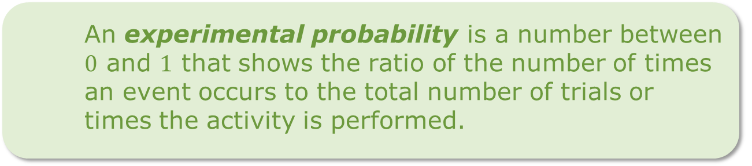

15.5.4 Guided Instruction: Experimental and Theoretical Probability
Consider the terms defined below and how they relate to the previous Exploration.
A theoretical probability is a number between $0$ and $1$ that represents the likelihood of an event in a theoretical model based on a sample space. If all outcomes in the sample space are equally likely, then the theoretical probability of an event is the ratio of the number of outcomes in the event to the number of outcomes in the sample space.
An experimental probability is a number between $0$ and $1$ that shows the ratio of the number of times an event occurs to the total number of trials or times the activity is performed.
volume 2, pg. 425

Slide 22
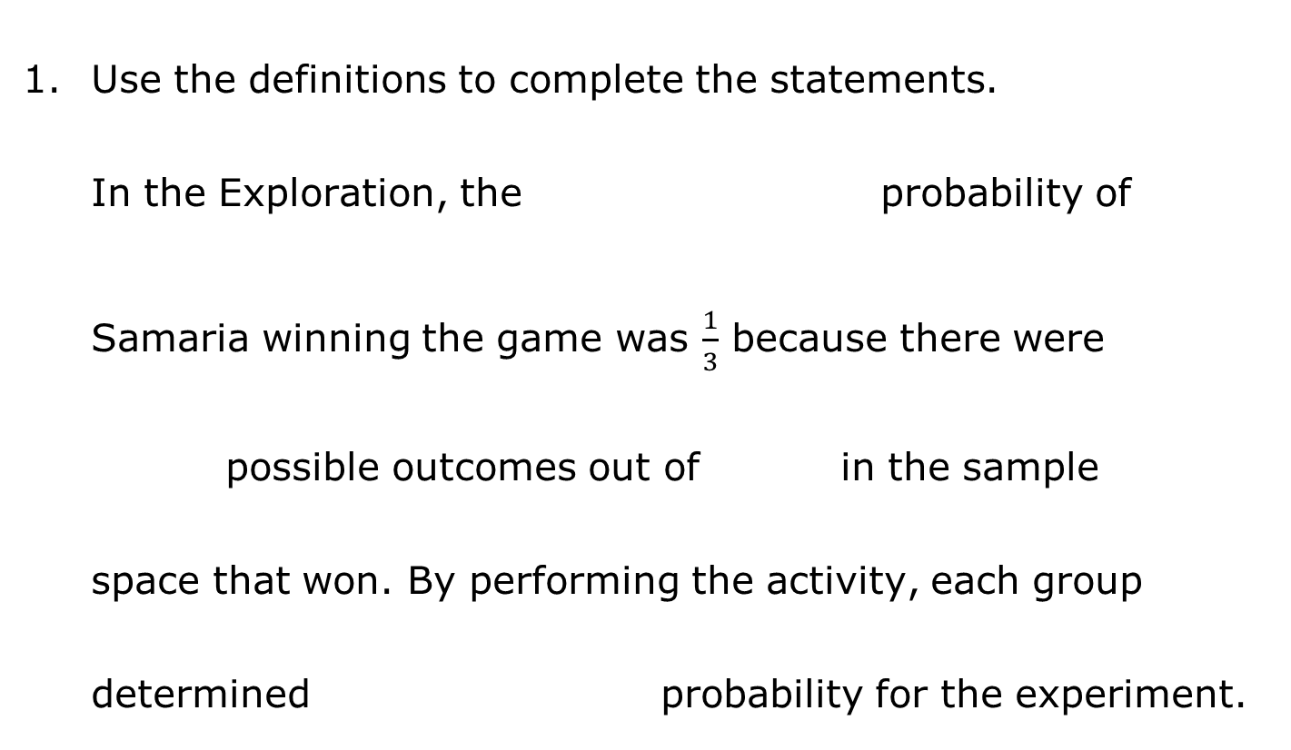
Use the definitions to complete the statements.
In the Exploration, the probability of Samaria winning the game was $\frac{1}{3}$ because there were possible outcomes out of in the sample space that won. By performing the activity, each group determined probability for the experiment.
experimental
theoretical
2
3
6
2
3
6
experimental
theoretical
volume 2, pg. 425

Slide 23

Try It
volume 2, pg. 425

Slide 24

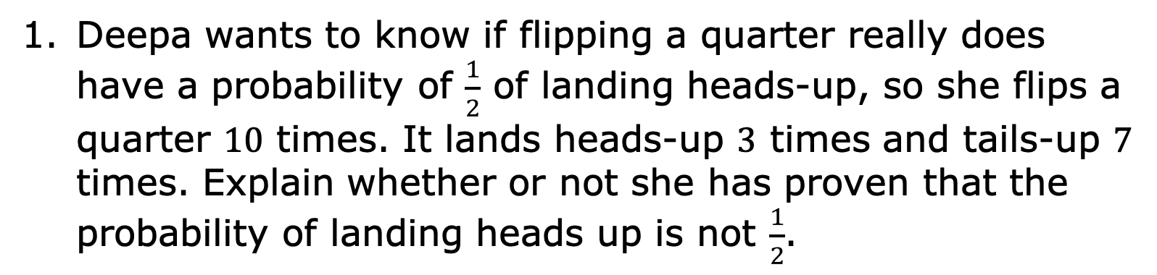
15.5.5 Try It: Experimental and Theoretical Probability
Deepa wants to know if flipping a quarter really does have a probability of $\frac{1}{2}$ of landing heads-up, so she flips a quarter $10$ times. It lands heads-up $3$ times and tails-up $7$ times. Explain whether or not she has proven that the probability of landing heads up is not $\frac{1}{2}$.
volume 2, pg. 425

Slide 25
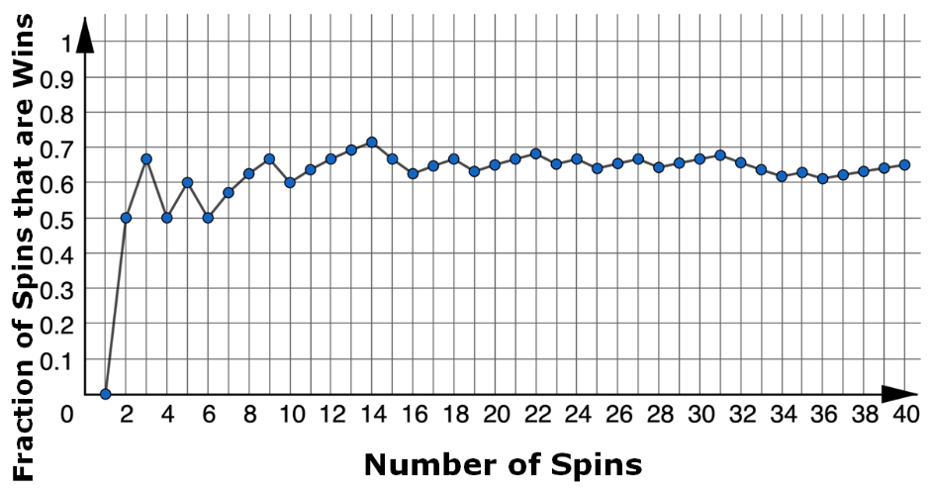

A spinner is spun $40$ times for a game. The graph shows the fraction of games that are wins.
Estimate the probability of a spin winning this game based on the graph.
What type of probability is your estimate?
volume 2, pg. 425

Slide 26

Wrap-Up
volume 2, pg. 426

Slide 27
15.5.6 Wrap-Up: Cool Down
Your friend was absent today and will need the notes from class. Write a quick note to help them understand the difference between the theoretical and experimental probability of a simple experiment.
volume 2, pg. 426

